Slide 1
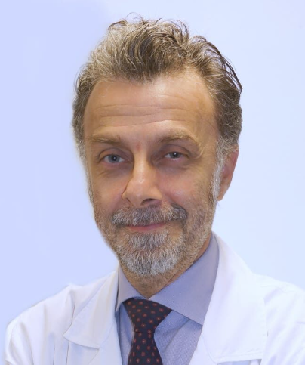
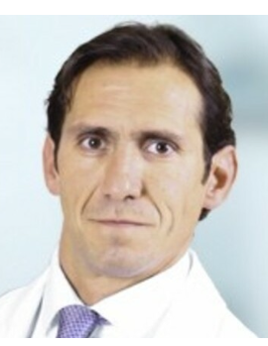
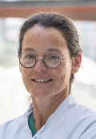

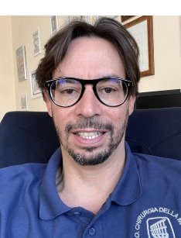
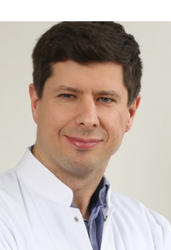
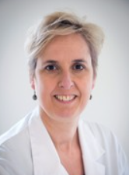
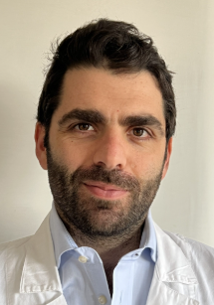
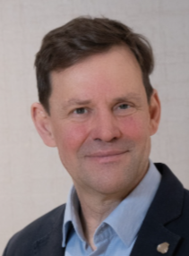
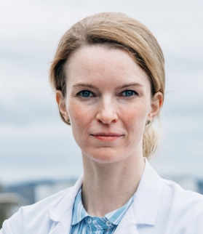
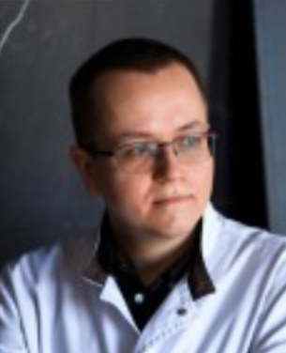
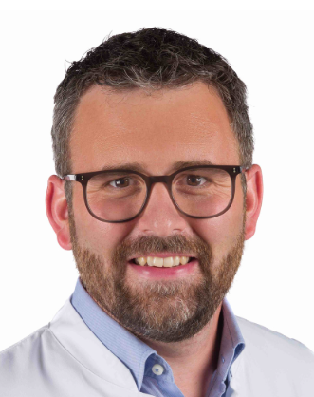
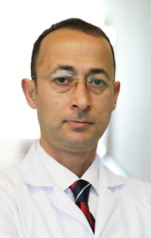
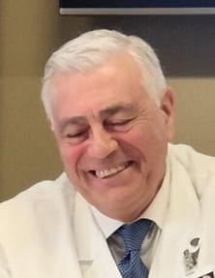
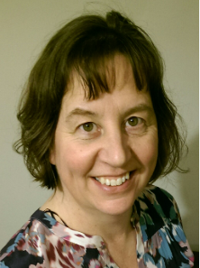
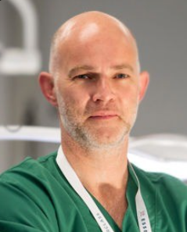
Pierluigi Tos
Italy
Ignacio Roger de Oña Espana
Brigitte Van der Heijden
Nederland
Inga Besmens
Switzerland
Massimo Corain
Italy
Piotr Czarnecki
Poland
Ilse Degreef
Belgium
Camillo Fulchignoni
Italy
Jonathan Hobby
United Kingdom
Andrii Lysak
Ukraine
Simon Oeckenpöhler
Germany
Fatih Kabakas
Turkey
Michele Riccio
Italy
Sarah Tucker
United Kingdom
Michiel Zuidam
Nederland

